Slide 1
Slave-master-managment

Slide 2
Agenda
Introduction
Goal
HL
Diagram
Data structure
Interface
Library
Tests

Slide 3
Introduction
Here you have to write the background, why we need this part? What does it related to?
When you receive a request for a map, the manager has to communicate with the slaves and choose at each stage which is the right thing to do.

Slide 4
Goal
Here write what we expected from this flow
Communication with the slaves to receive the images to create the map clearly and efficiently.

Slide 5
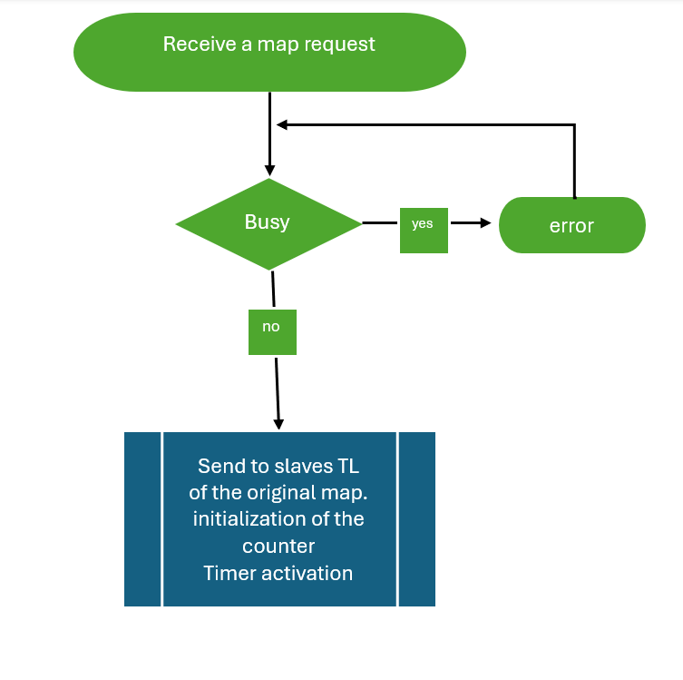
Diagram
v
Here put HL diagram of described HL in prev slide
we show it .

Slide 6
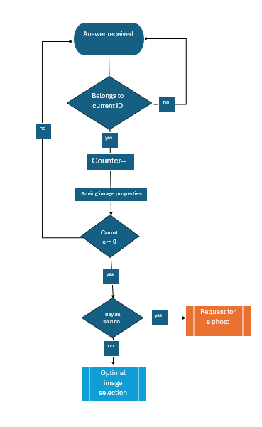
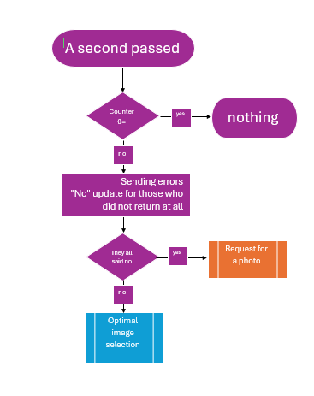

Slide 7
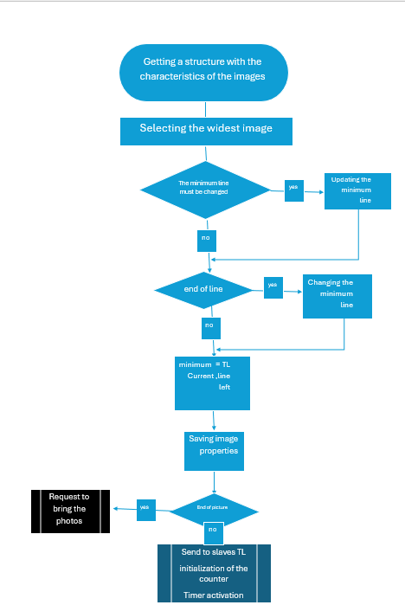

Slide 8
The explanation to the first diagram :
Receives a request for map image.
Checks if it is busy.
If yes – prints an error.
If no – sends a request to all drones with TL (needs communication API here), initializes a counter, and starts a timer.
Can save the request and return to it when finished (e.g., in a queue).

Slide 9
Explanation to the diagram of the timer:
Passing through a timer. When one second has passed - checks if the counter = 0. If yes – does nothing. If no – sends an error to those who haven't responded. If everyone has responded that they don't have it – sends a request for photographing. If not – selects the best image.
Explanation to the diagram of the master getting responses from slaves:
The master receives a response from a drone: Checks if it matches the current processId. If it matches the current processId – decreases the counter, saves the image data, and checks if the counter = 0. If yes – checks if the array is empty, meaning everyone responded that they don't have it – then sends a request for photographing. If not – sends it to an API that returns the optimal image. If it doesn't match the current processId – returns to wait for another response (ignores it).

Slide 10
Explanation to the diagram of selecting the optimal image:
Receives an unsorted array structure with all image data. Selects the widest image. Asks if it needs to update the minimum line. If updating is needed – updates the line. If updating is not needed – asks if it's the end of the line. If yes – updates the line to the end of the line and continues the process; if no – continues with the process (meaning the line equals the last TL). Saves the image data. Asks if it's the end of the map – if yes, returns an unsorted array of all optimal image data. If not – sends TL again to all drones, initializes a counter, and starts a timer.

Slide 11
Data structure
Which data structure you want to use?
Unsorted array that each member contains: TL, BR, slave number, ID of the request.
We needed it for save the properties at each stage And for save the properties of best images.

Slide 12
Interface
Do you need any API from other group/team/web?
communication API - in order to send messages between the master and slaves.
Scheduling processes – in order to know which req/res to handle first.

Slide 13
Library
Do you need any libraries ?
Timer- for the error handling - in order to check if all the slaves response in time.

Slide 14
Testing
How we can test this module?
Those are the tests we have to do in order to check our code:
1. End-to-End Test:
- Sending a request to the master of a specific type (handling request type for map).
- The master receives the request and checks if it's a type 1 request. If yes, it sends it to the handling API.
Random Drone Response -
- Manually filling an array of images by simply inputting image attributes.
- Selecting the optimal image.
- Inserting it into the response array.
- Returning the array.

Slide 15
2. Drone Handling Test:
- Sending a specific type request (handling request type from the master requesting a specific TL image).
- The drone receives the request (no need to check) and asks if it's a type 1 request. If yes, it sends it to the handling API.
- Perhaps? defining an array of images in advance and assigning an image or several images to each drone, allowing verification without access to storage.
then, Expected to check if it has a specific image and if yes, return "yes" with image data. If- not, return "no"
3. Master's Check on the Slaves Response
- Checking that the response received is of type yes/no.
- If yes, checking that reasonable image attributes are received according to the requested parameters; if not, checking that it returned empty.

Slide 16
4. Master's Successful Insertion Check of All Unsorted Array Properties
- Sending an array of responses from different drones (generated independently) and checking if the properties returned are within an unsorted array.
5. Checking the Optimal Image:
- Checking if the selected image is the optimal image.
- Sending an array with image properties.
- Checking if the selected image among all images is the optimal one.
-Checking if an array with optimal images was returned.
As mentioned above, I've already done this test in the first test - of end-to-end verification.

Slide 17
My Api’s
Save and send the array to image proc. | Choose the best image | Response from slave | Slave Get the request | Request to slaves | Request to operator to get a map | Name of Api
MTIP_SAVE_AND_SEND | M_CHOOSE_THE_BEST | STM_SEND_IMAGE_PROP | S_WORK_ON_REQ | MTS_ASK_FOR_IMAGES | M_GOT_REQ | Message Type
When the master has all the properties of all best images. | When the master has an array of all properties of the responses of the slaves. | when the slave finish to handle the request -it send response to the master. | When the schedular decide and when the master send message to him. | When the master get the request from the out. And also at each level in the part of getting the best image. | When someone send a request to get a map | Trigger-when will it happen?
The master send the array of the properties of the best images to the part of image processing. | The master has to run in a loop on the properties that given in the latest stage and to decide which is the best at each stage. | The master get the responses from all the slaves , enter them to non sorted array. | The slave has to recognize the message and to handle it – to response if he has an adjust image and if he has to get the properties from storage | the master has to send a message to the slaves with a request with TL. | the master has to get the request and handle this. | Handling-how to act when it happen

Slide 18
Thank you
Sara yifrach & Michal Reiner
0583213031
michal3213031@gmail.com
0548425177
sarayifrach177@gmail.com

